Slide 1

The Next Hottest City
By Dave’s Eagles (Group 4)
Andrew Gerashchenko, David Supple, Lucy Green, Natasha Nelson, Steve Pozzuoli

Slide 2
Introduction to our Project
Real Estate is an important topic in the financial world, especially in light of the pandemic, and the extreme fluctuations in the housing markets in cities and suburbs. We chose to examine real estate data and use the lessons learned from the data analysis to point out specific US cities that may see a real estate “boom” in the future. This information could be useful to buyers, sellers, investors or possibly someone looking to open a business.
We hope to answer the question of which city will see an increase in real estate prices based on the trends in the data. We will also attempt to determine which cities would be ideal for investing in real estate prior to this rush.

Slide 3
Data Dictionary of Terms
Supply Score- The supply score is an index representing a city’s median days on market ranking compared to other cities.
Demand Score- The demand score is an index representing a city’s listing page views per property ranking compared to other cities.
Hotness Rank-The specified city’s Hotness rank, by Hotness score, compared to all other zip codes, counties, and metro areas. A rank value of 1 is considered the hottest (highest Hotness score).
Hotness Score- The Hotness score is an equally-weighted composite metric of a geography’s supply score and demand score.
Hotness Rank Y/Y- The change in Hotness rank from the same month in the previous year. A positive value indicates that the geography’s Hotness has decreased (moved down in ranking), and a negative value indicates that its Hotness has increased (moved up in ranking).
Median Listing Price Y/Y - The percentage change in the median listing price from the same month in the previous year.
Median Days On Market Y/Y- The change in the median days on market from the same month in the previous year.
Unique Viewers Per Property Y/Y- The change in unique viewers a typical property receives in the specified geography from the same month in the previous year.
Mortgage Rate- The national mortgage rate for the corresponding month and year.
Tax Ranking- A measure of tax burden. Unlike tax rates, which vary widely based on an individual’s circumstances, tax burden measures the proportion of total personal income that residents pay toward state and local taxes.
Cost of Living- Calculated by comparing the prices for a representative sample of goods, services and other items that would be in a typical family budget.

Slide 4
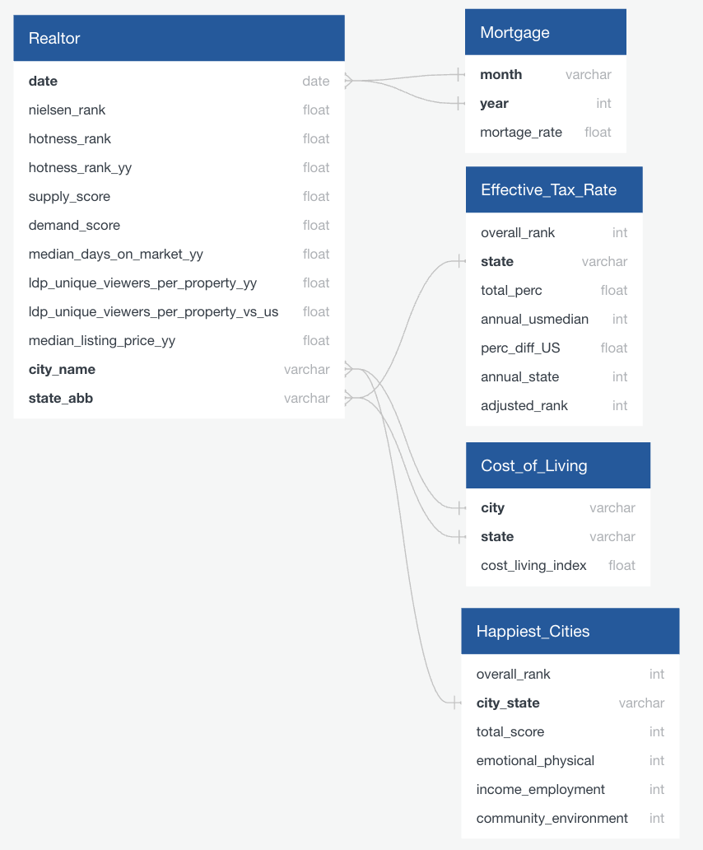
Data Sources
Our data is sourced primarily from Realtor.com. The main dataset includes 6 years' worth of monthly data from almost 800 unique cities in the United States. There are a total of just over 42,000 rows and 9 main features in the data set.
Datasets cleaned via Pandas in Jupyter Notebook, null values dropped, data types updated, text formatted to lowercase, create separate columns for ‘city’ and ‘state’ (via str.split function)
Focused on ‘year over year’ data to minimize variability in prices.
Sources:
Realtor.com - Main Dataset sourced from Kaggle
Tax Rates for 2021- WalletHub
Cost of Living Index - Advisor Smith
Happiness Ranking*
us_cities.csv

Slide 5
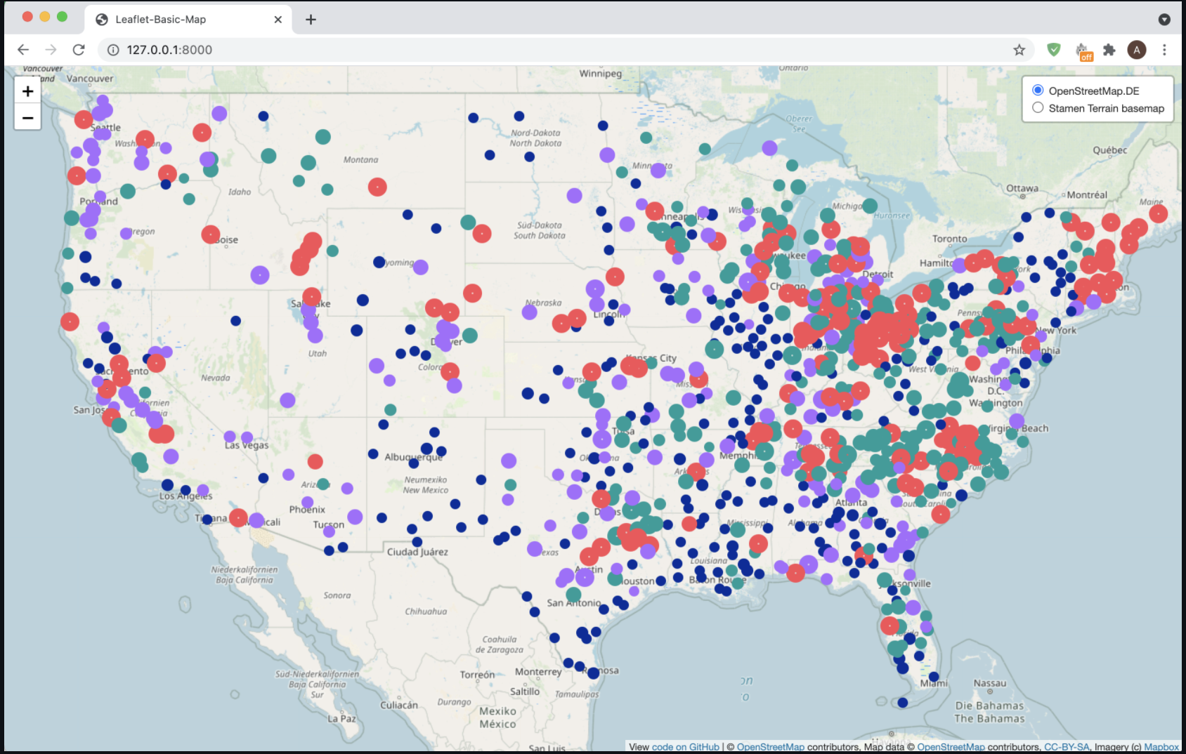
Database Connection and Coordinate Mapping
PgAdmin SQL database connected to Pandas with psycopg2 and loaded into the ML models
Output from the unsupervised machine learning models was joined with the dataset (us_cities.csv) containing longitude and latitude coordinates for HTML mapping and filtered to a single month to drop duplicates

Slide 6
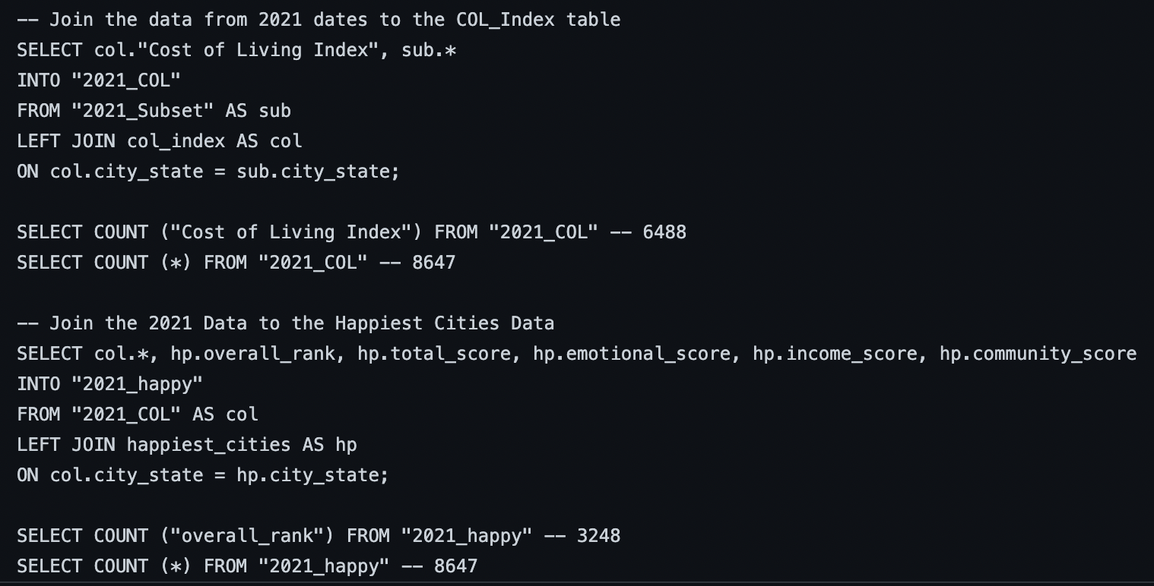
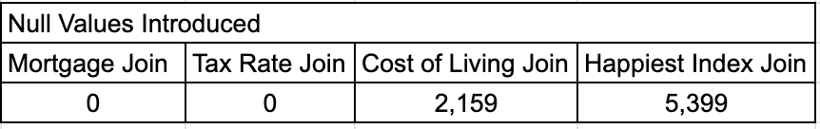
Data Cleaning and Joining Cont.
Converted state names to abbreviations using United States of America Python Dictionary with map function
Connected to PgAdmin via String Encoder engine and to_sql() function
Join methodology: sequential left joins onto the Realtor.com data to evaluate the number of null values introduced (see SQL_Join_ML_Dataset.txt and SQL Joins Supplementary.txt in the repository)
Tax, Cost of Living and Happiness index joins subset to Jan 2021 - July rows (8,600 rows)
Secondary Joins

Slide 7

Machine Learning Models
Unsupervised Clustering K-Means
Supervised Simple Linear Regression

Slide 8
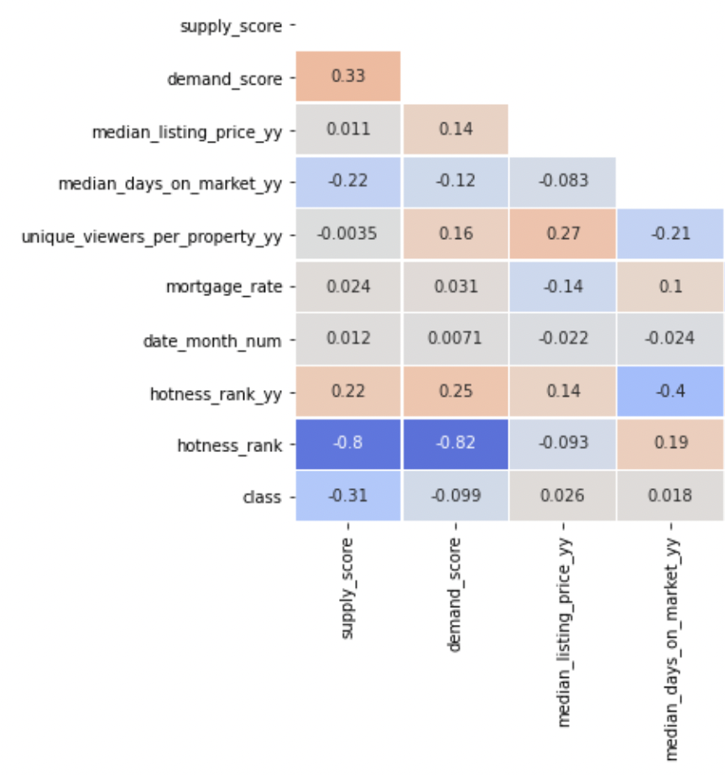
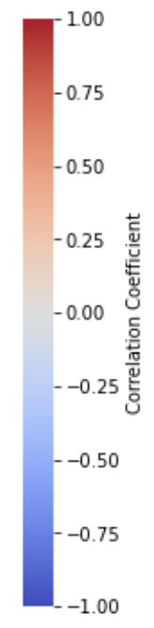
Unsupervised Clustering K-Means Model: Model Explanation
Correlation Matrix
What:
Identify patterns in the data
Why:
Strong correlations between supply score and
demand score with hotness rank.
To find inefficiencies in the data
How:
Clustering K-Means model

Slide 9
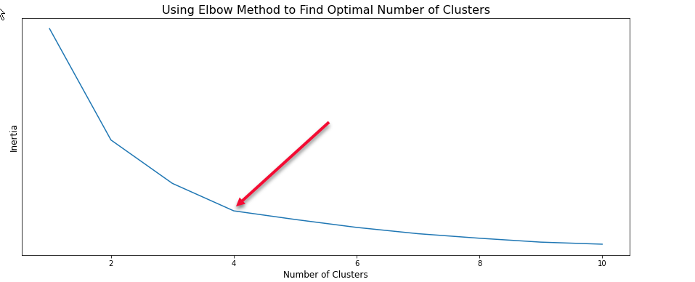
Unsupervised Clustering K-Means Model: Elbow Method

Slide 10
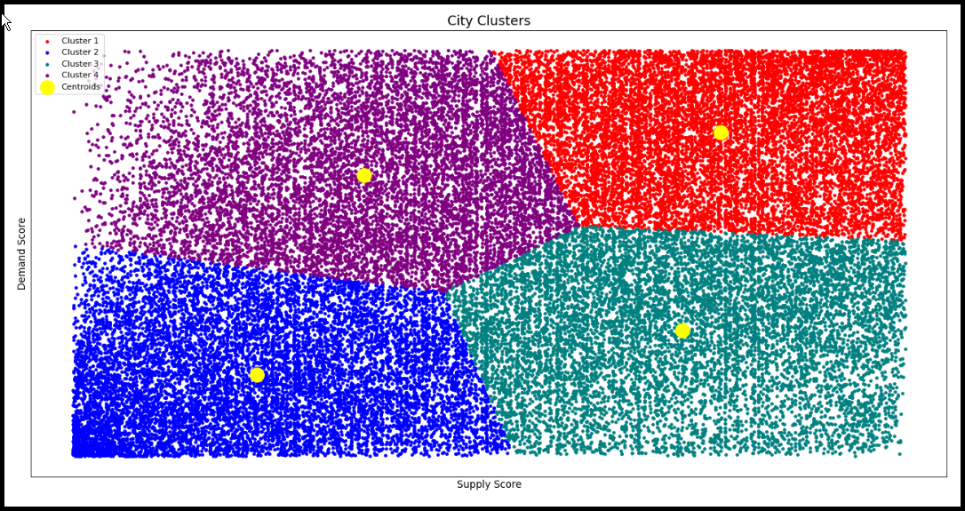
Unsupervised Clustering K-Means Model: Visualize Clusters

Slide 11
Supervised Learning - Predict Hotness Rank: Model Explanation
What:
Predict hotness rank
Why:
Compare predicted hotness ranks to the real hotness ranks and look for inefficiencies.
How:
Same dataset was used for unsupervised cluster model.
Use Fit method to train the simple linear regression model.
Visualize Train set and Test set results.

Slide 12
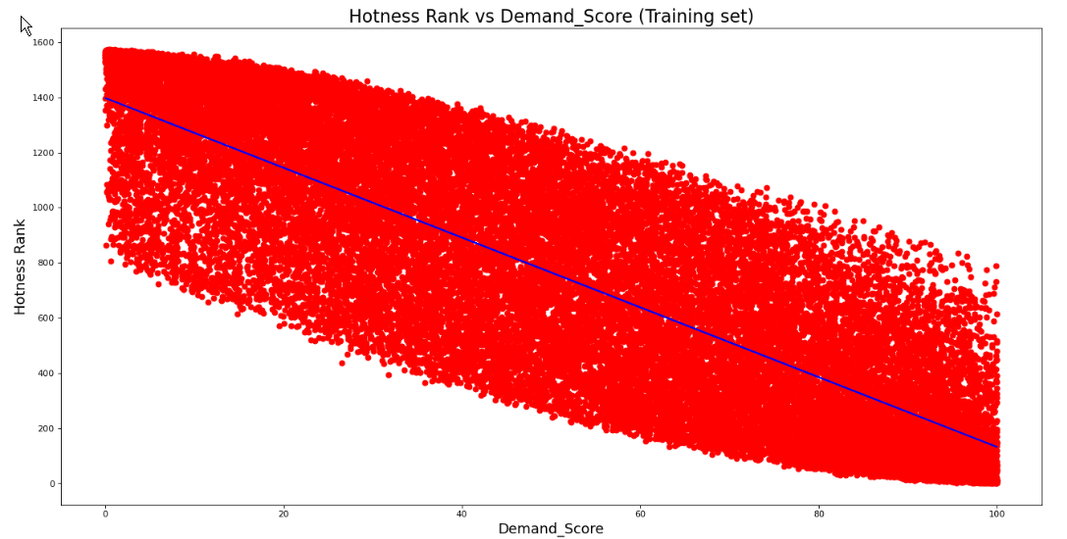
Predict Hotness Rank: Visualize Train Set Results

Slide 13
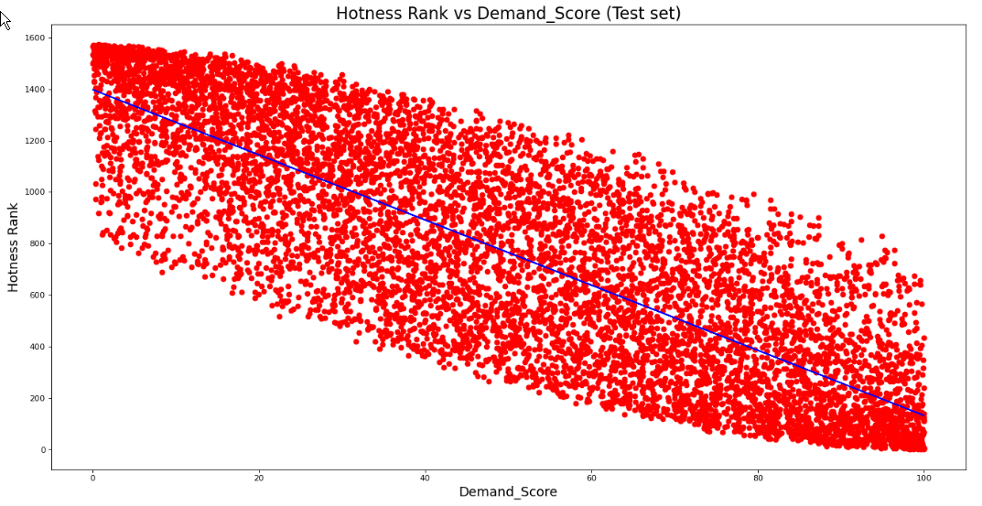
Predict Hotness Rank: Visualize Test Set Results

Slide 14
Predict Hotness Rank: Accuracy Scores
Accuracy scores (67%) were very similar.
The low accuracy scores of our model are due to the limitations of our dataset.
The variance in features within each individual city is wide.

